Slide 1
Madurai Aavin Milk Dairy
Supply Chain Optimization
Team 6
Baturalp Topcu
Nan Wang
Thanh Tam Luu
Veronika Becvarova

Slide 2
About Madurai Aavin Milk Dairy (MAMD)
One of the largest dairy entities in southern India
India is the world’s largest consumer of dairy products, 100% consumption of its own production
Dairy sector: Organized (MAMD) and Unorganized
Organized dairy industry: 60% market share
Increasing demand for dairy products
Especially Premium Milk
Notes:
Madurai Aavin Milk Dairy is one of the largest dairy entities in southern India. The company has been operating in the Madurai and Theni Districts since 1982 as part of the Indian organized dairy sector that has 60% of the market share. As the Indian economy has been growing for the past few years, so has the demand for milk, especially demand for premium milk, whose production is going to be the subject for optimization in this presentation.

Slide 3
Premium Milk Production
Raw milk from farmers
Recombination using SMP and Butter
Raw milk from other dairies
Raw milk
Raw milk
Outside sources
Raw milk
Processing
SMP
Butter
Processing
Premium milk
Recombination
Premium milk
Processing
Premium milk
Appendix
Notes:
Let’s first walk through how the premium milk is produced. The premium production can be divided into 3 methods. It can be produced using raw milk procured from the farmers or raw milk purchased from other dairies. The concise process is very straightforward – they procure the raw milk which they will process into the premium milk. The third method looks a little more complicated – premium milk is produced using the recombination of SMP (skimmed milk powder) and butter, which can either be prepared from raw milk or bought from outside sources.
Anyways, it is clear that the company faces decisions on the premium milk sources and whether to make or buy.

Slide 4
Business Problem
Seasonal demand
Fierce competition
Demand-supply gap: 30%
Rising costs
Appendix
Notes:
The biggest ongoing problem here is that the demand keeps increasing but the milk production has not improved to match the increased demand, resulting in a 30% gap in 2011 between supply and demand. There were other challenges too – like dealing with the seasonal demand, fierce competition, and rising productions costs – all of which urge the company too look for a different approach, possibly an optimization, to their dairy milk production.

Slide 5
Business Objective
Demand
Supply
Objective: Meeting 100% Demand
and Profit Maximization
Appendix
Notes:
The objective was to improve the ability to meet the total demand. Moreover, due to the market competitions, there is a strong need to find the best production-mix to manage the milk-producing plan in order to maximize the total profit. For that, we developed a Mixed Integer Linear Programming model that will be used as a decision support tool for strategic and operational analysis.

Slide 6
Key Assumptions
1
2
MAMD will only produce Premium Milk
MAMD purchase Butter and SMP from outside sources once a month in advance
3
4
Butter and SMP
are imported and
the procurement costs include transportation cost
MAMD do not procure all available raw milk from the farmers but only the forecasted amount
Appendix
Notes:
So before we move forward, I’d like to clarify some of the key assumptions that we made.
The company will only produce Premium Milk because as per the case, the management is ready to compromise on all the other products since the demand for premium milk is higher than the supply of raw milk.
The company purchases Butter and SMP from outside sources because the procurement costs are lower than the in-house production. Also, it is expected that MAMD would not have any excess raw milk to produce Butter and SMP given the high demand.
Butter and SMP are imported and the procurement costs include transportation cost.
The company has flexible terms with the farmers so they do not have to procure all available raw milk from the farmers but only procure the forecasted amount.

Slide 7
Demand Seasonality
High-demand months:
Summer months &
October – December
Festivals
Holidays
Low-demand months:
February – March
Appendix
Notes:
To optimize production plans, one of the most important tasks was to forecast the demand as accurate as possible, which is critical because we need to plant resources and inventory in advance according to the level of demand in each month. We used linear regression with dummy variables to produce forecast that takes into account both the seasonality and year-to-year trends.
The highest peaks are in the months of October. This is most likely because of the Diwali festival during which families get together and cook a lot of desserts that require milk, or it is simply used in worship. Another peaks are observed in December as well as the summer months, again most probably because of the other Hindu festivals and holidays.
On the other hand, February and March belong to the lower-demand months.

Slide 8
Daily Production Plan April 2011 (13th - 30th)
Appendix
Notes:
When it comes to the short-term optimization, using the forecast that satisfies about 81% of the demand in April 2011, we were able to produce an optimized scheduling plan from April 13th to April 30th that meets the total demand. The gap in the supply and demand is filled through milk recombination using outsourced butter and SMP. However, most of the production still heavily relies on the raw milk procured from the farmers except for the 26th day in the month where the daily premium milk production will be prepared from butter and SMP that we have in storage.

Slide 9
Profitability Comparison
Not Optimized (81% Demand Satisfied)
Sales | INR 105,523,689
Cost | INR 91,134,095
Profit | INR 14,389,594
Optimized (100% Demand Satisfied)
Sales | INR 120,694,310
Cost | INR 102,003,909
Profit | INR 18,690,401
Increase = INR 4,300,807
% Increase = 29.89%
Appendix
Notes:
To compare to profitability statements of the not optimized model and the optimized model, although the cost increased in the optimized model, so did the sales but more. The results show that the total profit can be increase by almost 30% using the optimized production plan.

Slide 10
Summary
Meeting the objectives:
SMP and butter in the remaining stock should be converted to premium milk to meet the demand
To maximize the profit, MAMD don't need to buy additional raw milk from other companies, but instead will keep incurring storage cost for butter (and SMP)
81% of demand will be produced using raw milk procured from the farmers and 19% of premium milk production will be recombined using SMP and butter
Appendix
Notes:
To sum up, in order to meet the total demand, SMP and butter in the remaining stock should be converted to milk to satisfy the demand. To maximize the profit, the company does not need to buy additional raw milk from other companies, but instead will keep incurring storage costs since MAMD will keep converting butter and SMP to premium milk, which on the other hand appears to bring favorable results. 81% of the demand will be produced using raw milk procured from the farmers and 19% of premium milk production will be recombined using SMP and butter.

Slide 11
Recommendation
Farmers
Communicate the goals and plans
Revisit the payment policy and consider full or partial advance payments
Cooperate with dairy farmers to carry out centralized breeding management (i.e. data recording, genetic evaluation) and epidemic prevention work in a unified way
Import Partners
Plan in advance and establish good terms with the partners
Assign teams to keep track of the vendors
Other
Put more control over production and purchasing (i.e. daily tracking reports)
Keep track of the market trends/events and adjust plans accordingly (changing festival dates)
Appendix
Notes:
Now that the company knows the optimal production-mix plan, it has to ensure the quality and increase the efficiency of collecting the resources from the partners.
With the farmers, the company should communicate their goals and plans clearly, revisit the payment policy and consider full or partial advance payments, and cooperate with dairy farmers to carry out centralized breeding management to reduce disease risks, for example data recording or genetic evaluation.
With the import partners, the company is recommended to plan in advance and establish good terms with the partners. Moreover, they should also assign internal teams to keep track of the vendors – their feedback, fulfillment, changes and so on.
The company should put more control over production and purchasing to make sure that everything runs smoothly according to the plan. Lastly, it is strongly recommended to keep track of the market trends/events and adjust plans accordingly. For example, the festival dates are changing every year and instead of October, November can become the highest-demand month.

Slide 12
Key Takeaways
Excel Solver is limited to the number of constraints and decision variables
Ability to formulate a real-world problem using a mathematical model
Taking context and using external research to make sense of the model
There are multiple optimal solutions
Appendix
Notes:
When dealing with the model, we found out that Excel Solver is very limited to the number of constraints and decision variables. However, we were still able to formulate a real-world problem using the mathematical model. All of which required taking context and using external research to make sense of the model. Lastly, there was not just one correct answer but there were multiple optimal solutions.

Slide 13
Thank you!
Q&A

Slide 14
Appendix
Decision Variables
Objective Function
Constraints
Revenue and Cost Structure
Estimated Daily Demand and Supply (April 2011)
Daily Production Plan (April 13th – April 30th )
Notes:
Now that the company knows the optimal production-mix plan, it has to ensure the quality and increase the efficiency of collecting the resources from the partners.
With the farmers, the company should communicate their goals and plans clearly, revisit the payment policy and consider full or partial advance payments, and cooperate with dairy farmers to carry out centralized breeding management to reduce disease risks, for example data recording or genetic evaluation.
With the import partners, the company is recommended to plan in advance and establish good terms with the partners. Moreover, they should also assign internal teams to keep track of the vendors – their feedback, fulfillment, changes and so on.
The company should put more control over production and purchasing to make sure that everything runs smoothly according to the plan. Lastly, it is strongly recommended to keep track of the market trends/events and adjust plans accordingly. For example, the festival dates are changing every year and instead of October, November can become the highest-demand month.

Slide 15
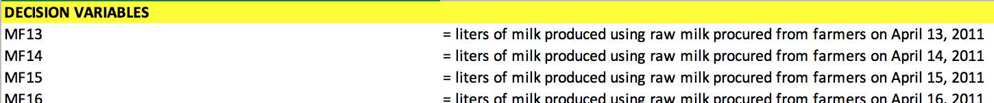



Decision Variables
Appendix
Notes:
Now that the company knows the optimal production-mix plan, it has to ensure the quality and increase the efficiency of collecting the resources from the partners.
With the farmers, the company should communicate their goals and plans clearly, revisit the payment policy and consider full or partial advance payments, and cooperate with dairy farmers to carry out centralized breeding management to reduce disease risks, for example data recording or genetic evaluation.
With the import partners, the company is recommended to plan in advance and establish good terms with the partners. Moreover, they should also assign internal teams to keep track of the vendors – their feedback, fulfillment, changes and so on.
The company should put more control over production and purchasing to make sure that everything runs smoothly according to the plan. Lastly, it is strongly recommended to keep track of the market trends/events and adjust plans accordingly. For example, the festival dates are changing every year and instead of October, November can become the highest-demand month.

Slide 16
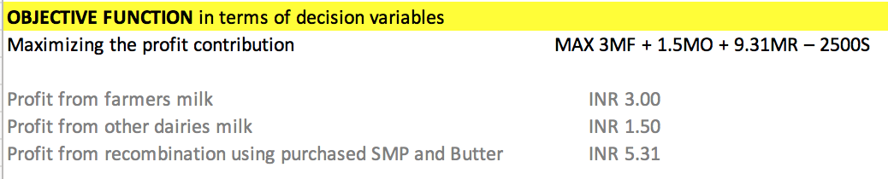
Objective Function
Appendix
Notes:
Now that the company knows the optimal production-mix plan, it has to ensure the quality and increase the efficiency of collecting the resources from the partners.
With the farmers, the company should communicate their goals and plans clearly, revisit the payment policy and consider full or partial advance payments, and cooperate with dairy farmers to carry out centralized breeding management to reduce disease risks, for example data recording or genetic evaluation.
With the import partners, the company is recommended to plan in advance and establish good terms with the partners. Moreover, they should also assign internal teams to keep track of the vendors – their feedback, fulfillment, changes and so on.
The company should put more control over production and purchasing to make sure that everything runs smoothly according to the plan. Lastly, it is strongly recommended to keep track of the market trends/events and adjust plans accordingly. For example, the festival dates are changing every year and instead of October, November can become the highest-demand month.

Slide 17
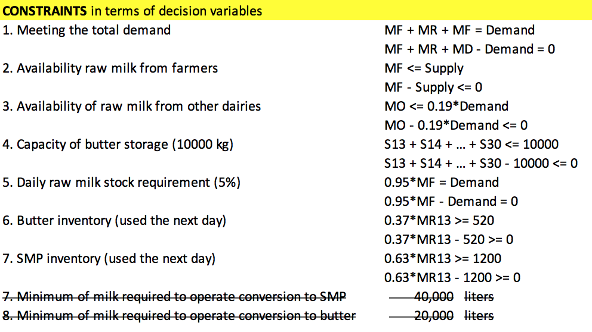
Constraints
Appendix
Notes:
Now that the company knows the optimal production-mix plan, it has to ensure the quality and increase the efficiency of collecting the resources from the partners.
With the farmers, the company should communicate their goals and plans clearly, revisit the payment policy and consider full or partial advance payments, and cooperate with dairy farmers to carry out centralized breeding management to reduce disease risks, for example data recording or genetic evaluation.
With the import partners, the company is recommended to plan in advance and establish good terms with the partners. Moreover, they should also assign internal teams to keep track of the vendors – their feedback, fulfillment, changes and so on.
The company should put more control over production and purchasing to make sure that everything runs smoothly according to the plan. Lastly, it is strongly recommended to keep track of the market trends/events and adjust plans accordingly. For example, the festival dates are changing every year and instead of October, November can become the highest-demand month.

Slide 18
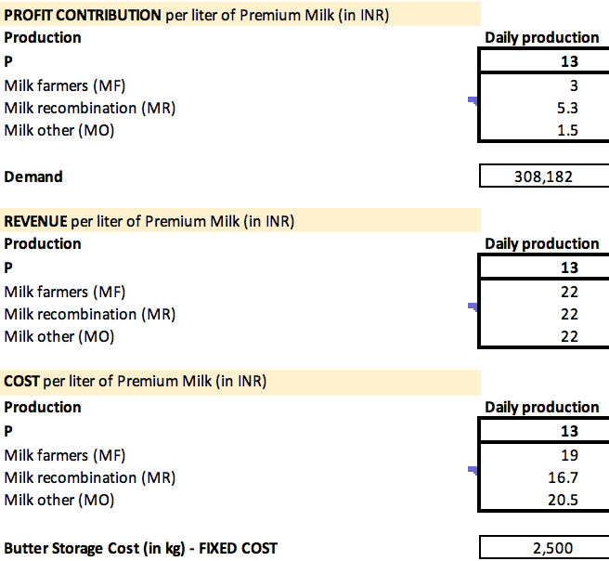
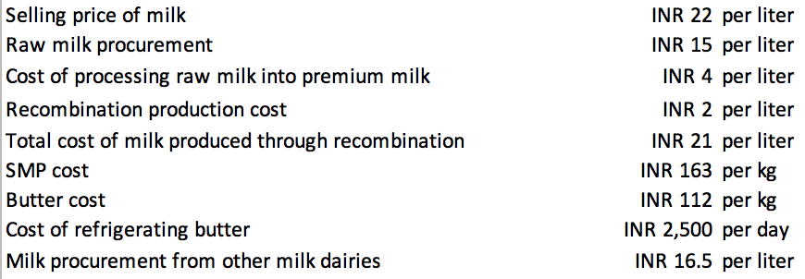
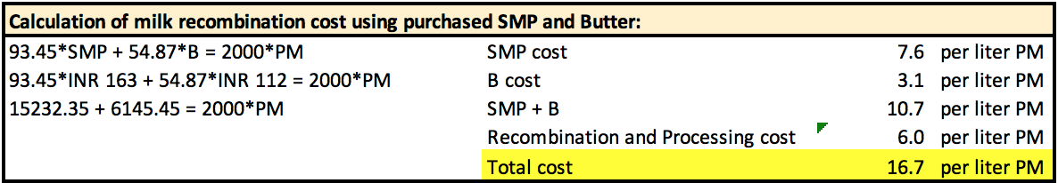
Revenue and Cost Structure
Appendix
Notes:
Now that the company knows the optimal production-mix plan, it has to ensure the quality and increase the efficiency of collecting the resources from the partners.
With the farmers, the company should communicate their goals and plans clearly, revisit the payment policy and consider full or partial advance payments, and cooperate with dairy farmers to carry out centralized breeding management to reduce disease risks, for example data recording or genetic evaluation.
With the import partners, the company is recommended to plan in advance and establish good terms with the partners. Moreover, they should also assign internal teams to keep track of the vendors – their feedback, fulfillment, changes and so on.
The company should put more control over production and purchasing to make sure that everything runs smoothly according to the plan. Lastly, it is strongly recommended to keep track of the market trends/events and adjust plans accordingly. For example, the festival dates are changing every year and instead of October, November can become the highest-demand month.

Slide 19
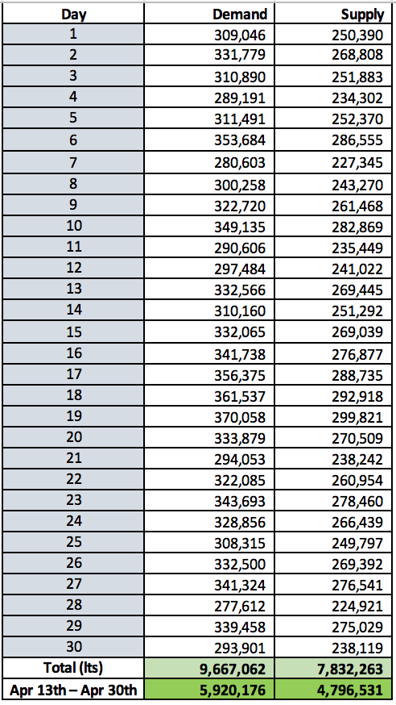
Estimated Daily
Demand and Supply April 2011
Appendix
Notes:
Now that the company knows the optimal production-mix plan, it has to ensure the quality and increase the efficiency of collecting the resources from the partners.
With the farmers, the company should communicate their goals and plans clearly, revisit the payment policy and consider full or partial advance payments, and cooperate with dairy farmers to carry out centralized breeding management to reduce disease risks, for example data recording or genetic evaluation.
With the import partners, the company is recommended to plan in advance and establish good terms with the partners. Moreover, they should also assign internal teams to keep track of the vendors – their feedback, fulfillment, changes and so on.
The company should put more control over production and purchasing to make sure that everything runs smoothly according to the plan. Lastly, it is strongly recommended to keep track of the market trends/events and adjust plans accordingly. For example, the festival dates are changing every year and instead of October, November can become the highest-demand month.

Slide 20
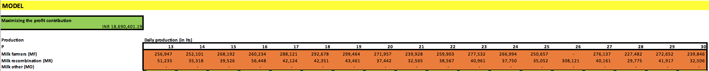

Daily Production Plan April 13th – 16th 2011
Appendix
Notes:
Now that the company knows the optimal production-mix plan, it has to ensure the quality and increase the efficiency of collecting the resources from the partners.
With the farmers, the company should communicate their goals and plans clearly, revisit the payment policy and consider full or partial advance payments, and cooperate with dairy farmers to carry out centralized breeding management to reduce disease risks, for example data recording or genetic evaluation.
With the import partners, the company is recommended to plan in advance and establish good terms with the partners. Moreover, they should also assign internal teams to keep track of the vendors – their feedback, fulfillment, changes and so on.
The company should put more control over production and purchasing to make sure that everything runs smoothly according to the plan. Lastly, it is strongly recommended to keep track of the market trends/events and adjust plans accordingly. For example, the festival dates are changing every year and instead of October, November can become the highest-demand month.

Slide 21
References
Fairs and Festivals India,All About India Fairs,Indian Festivals Info. (2020). Retrieved 18 March 2020, from https://www.india-tourism.net/fairs-festivals.htm
Supply Chain Optimization at Madurai Aavin Milk Dairy Case Solution And Analysis, HBR Case Study Solution & Analysis of Harvard Case Studies. Thecasesolutions.com. (2020). Retrieved 18 March 2020, from https://www.thecasesolutions.com/supply-chain-optimization-at-madurai-aavin-milk-dairy-2-45342.
Fairs and Festivals India,All About India Fairs,Indian Festivals Info. (2020). Retrieved 18 March 2020, from https://www.india-tourism.net/fairs-festivals.htm
Successful agricultural transformations: Six core elements of planning and delivery. (2020). Retrieved 18 March 2020, from https://www.mckinsey.com/industries/chemicals/our-insights/successful-agricultural-transformations-six-core-elements-of-planning-and-delivery
Fairs and Festivals India,All About India Fairs,Indian Festivals Info. India-tourism.net. (2020). Retrieved 18 March 2020, from https://www.india-tourism.net/fairs-festivals.htm.
The 8 Most Popular Festivals in India. (2020). Retrieved 18 March 2020, from https://www.tripsavvy.com/most-popular-festivals-in-india-1539299
(2020). Retrieved 18 March 2020, from https://dairymarkets.org/PubPod/Reference/Library/Craig,Norback&Johnson.1989.pdf
(2020). Retrieved 18 March 2020, from https://www.researchgate.net/figure/Analysis-on-collection_tbl6_325244282
SUPPLY CHAIN OPTIMIZATION AT MADURAI MILK DAIRY Case Solution and Analysis, HBS Case Study Solution & Harvard Case Analysis. (2020). Retrieved 18 March 2020, from https://caseism.com/supply-chain-optimization-at-madurai-milk-dairy-87540
Journalofdairyscience.org. (2020). Retrieved 18 March 2020, from https://www.journalofdairyscience.org/article/S0022-0302(86)80552-5/pdf.
Scielo.br. (2020). Retrieved 18 March 2020, from http://www.scielo.br/pdf/sa/v73n1/0103-9016-sa-73-1-0051.pdf.
Procurement | Aavin Milk | Madurai aavin milk factory | Aavin milk madurai. Aavinmadurai.com. (2020). Retrieved 18 March 2020, from http://www.aavinmadurai.com/procurement.
Mixed-Integer Linear Programming approaches to shelf-life-integrated planning and scheduling in yoghurt production. Taylor & Francis. (2020). Retrieved 18 March 2020, from https://www.tandfonline.com/doi/abs/10.1080/00207540500161068?src=recsys&journalCode=tprs20.
Diva-portal.org. (2020). Retrieved 18 March 2020, from https://www.diva-portal.org/smash/get/diva2:839174/FULLTEXT01.pdf.
(2015, 06). Supply Chain Optimization at Madurai Aavin Milk Dairy. OtherPapers.com. Retrieved 06, 2015, from https://www.otherpapers.com/essay/Supply-Chain-Optimization-at-Madurai-Aavin-Milk-Dairy/54266.html
Notes:
Now that the company knows the optimal production-mix plan, it has to ensure the quality and increase the efficiency of collecting the resources from the partners.
With the farmers, the company should communicate their goals and plans clearly, revisit the payment policy and consider full or partial advance payments, and cooperate with dairy farmers to carry out centralized breeding management to reduce disease risks, for example data recording or genetic evaluation.
With the import partners, the company is recommended to plan in advance and establish good terms with the partners. Moreover, they should also assign internal teams to keep track of the vendors – their feedback, fulfillment, changes and so on.
The company should put more control over production and purchasing to make sure that everything runs smoothly according to the plan. Lastly, it is strongly recommended to keep track of the market trends/events and adjust plans accordingly. For example, the festival dates are changing every year and instead of October, November can become the highest-demand month.

